Slide 1


Tabular Data Analysis
2025. 12. 18.
JangHoon Chun
Department of Medical Device Industry,
Gangnam Severance Hospital,
Yonsei University College of Medicine

Slide 2
1. What’s discussed in the last meetings
Check code implementation error and feature error in input in 5-fold cv as a result of code analysis
Please check directly with Excel data and see in-depth how the data is organized and split
Ensure that the input and output are set up properly and securely

Slide 3
2. Research Summary
Re-implement the code to check deeply for any errors or missing
After the model test, store it as Excel data to check and analyze the data directly
Compare Holdout and 5-fold cv results

Slide 4
3. Detailed progress
인체 임상 변수
약물 복용 변수
Variable | Description | Units / Classification
File Analyzed | 환자 / 케이스 식별자 | ID
Osteoporosis | 골다공증 여부 (0=정상, 1=골다공증) | Binary
Age | 나이 | 세
진료년월일 | 검사 날짜 | YYYY-MM-DD
키 | 키 | cm
체중 | 몸무게 | Kg
BMI | 체질량지수 | kg/m²
허리둘레 | 허리 둘레 | cm
근육량SoftLeanMass | 부위별 평균 근육량 | kg
체지방율BodyFat | 체지방 비율 | %
체지방량FatMassKg | 체지방 총량 | kg
복부지방율WHRatio | 복부지방률 (WH Ratio) | %
복부내장지방량 | 내장지방량 | kg
복부피하지방량 | 피하지방량 | kg
초경연령ALL | 초경 시작 나이 | 세
폐경여부 | 폐경 여부 (1=예, 0=아니오) | Binary
출산횟수ALL | 출산 횟수 | Count
Variable | Units / Classification
혈압약 | no: 0 / yes: 1
당뇨약 | no: 0 / yes: 1
고지혈증약 | no: 0 / yes: 1
흡연 | no: 0 / current: 1 / exsmoke: 2
운동 | no: 0 / yes: 1
음주 | no: 0 / yes: 1
유방암 가족력 이력 | no: 0 / yes: 1

Slide 5
3. Detailed progress
영상 파생 변수
Mammography로부터 계산된 값
Variable | Description | Units / Classification
Average breast area | 유방 전체 면적 평균 | cm²
Average dense area | 치밀 조직 면적 평균 | cm²
Average breast density | 유방 내 치밀조직 비율 | %
Breast density grading | 유방 밀도 등급 | 1~4 단계
*BIRADS Category | BI-RADS 평가 카테고리 | 1~5 등급
*BIRADS (Breast Imaging Reporting and Data System)

Slide 6
3. Detailed progress
환자 데이터
전체 8,768명 중 폐경 환자군만 고려
<폐경 환자군 내 정상/골다공증 비율>
Group | Samples
Total | 3,961(100)
Normal | 3,475(87.7)
Osteoporosis | 486(12.3)

Slide 7
3. Detailed progress
주요 변수별 정상/골다공증 분포 비교
Performed t-test
Type | Age | BMI | BreastDensity(%)AVG | BreastArea(sqcm)AVG | DenseArea(sqcm)AVG
t-stat | -10.18 | 7.86 | -2.09 | 4.84 | 2.53
p-value | <0.001 | <0.001 | 0.037 | <0.001 | 0.012
Variable | Classification | N_Sample | mean | std
Age | Total | 3,961 | 60.3 | 7.34
 | Normal(0) | 3,475 | 59.81 | 7.07
 | Osteoporosis(1) | 486 | 63.78 | 8.18
BMI | Total | 3,961 | 23.07 | 3.12
 | Normal(0) | 3,475 | 23.21 | 3.12
 | Osteoporosis(1) | 486 | 22.07 | 2.99
BreastDensity(%)AVG | Total | 3,961 | 26.75 | 11.45
 | Normal(0) | 3,475 | 26.59 | 11.24
 | Osteoporosis(1) | 486 | 27.87 | 12.81
BreastArea(sqcm)AVG | Total | 3,961 | 122.54 | 38.10
 | Normal(0) | 3,475 | 123.57 | 38.38
 | Osteoporosis(1) | 486 | 115.22 | 35.22
DenseArea(sqcm)AVG | Total | 3,961 | 29.73 | 10.59
 | Normal(0) | 3,475 | 29.87 | 10.71
 | Osteoporosis(1) | 486 | 28.68 | 9.58

Slide 8
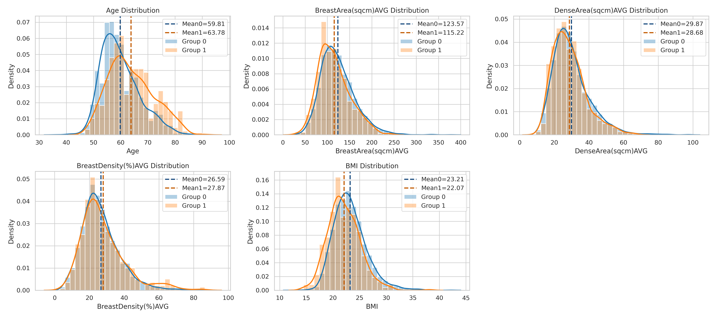
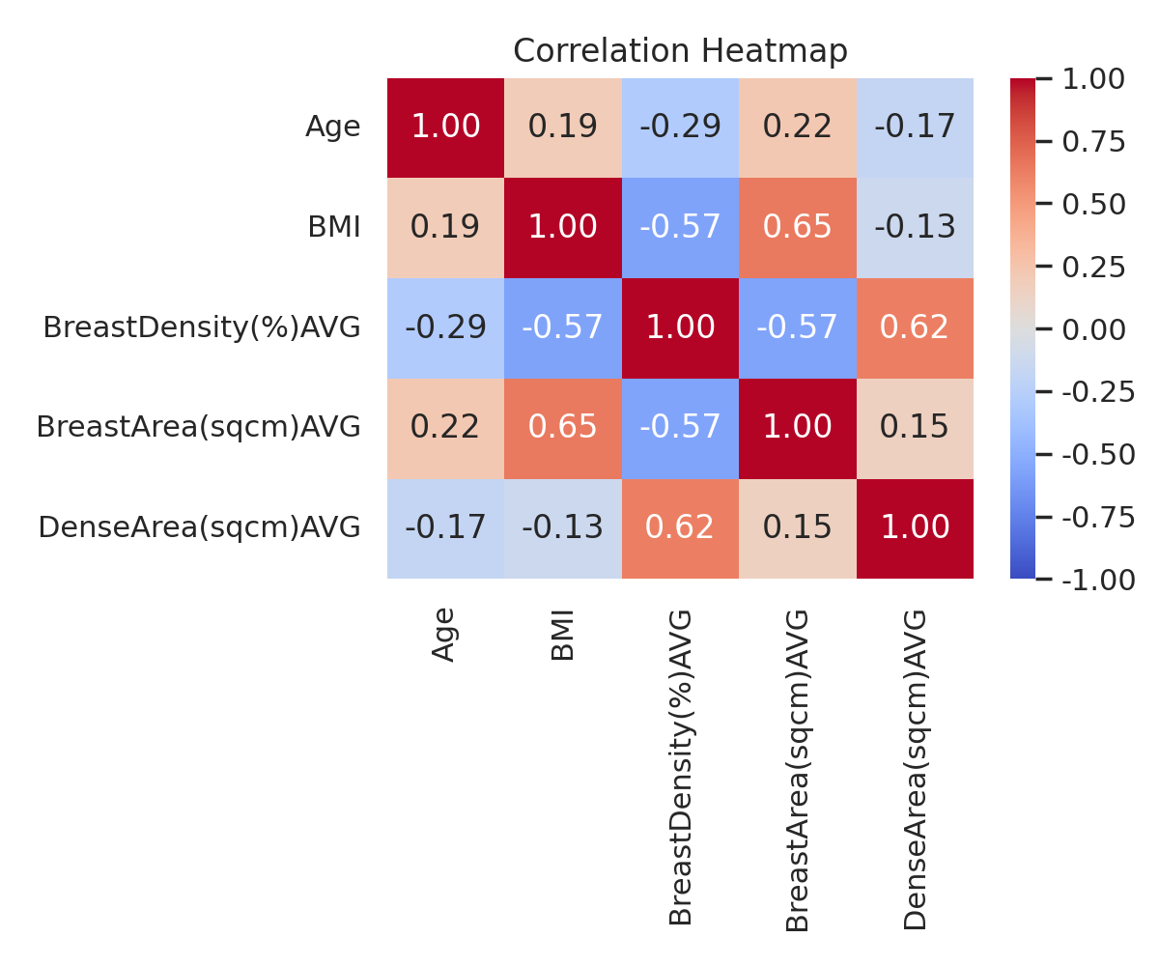
3. Detailed progress
주요 변수별 정상/골다공증 분포 비교

Slide 9
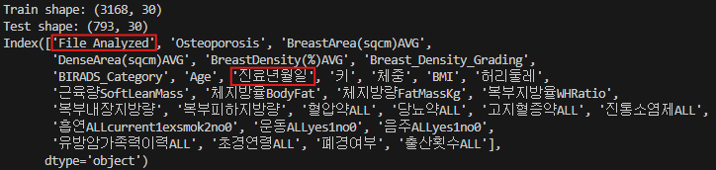
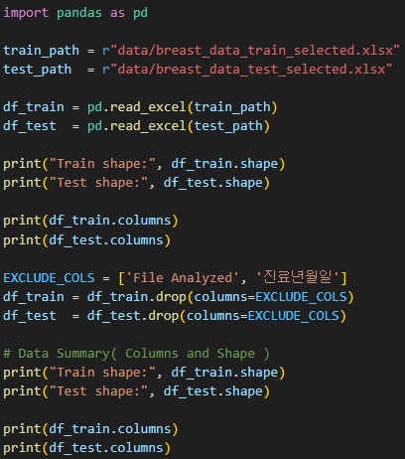
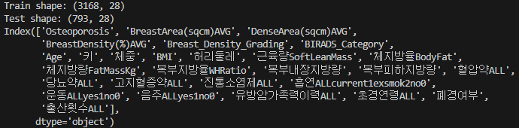
3. Detailed progress
Python Code & Print Check
Upload Train and Test Dataset
File Analyzed (Date of Treatment)
Check Dataset's Size
Verify that the upload is done properly

Slide 10
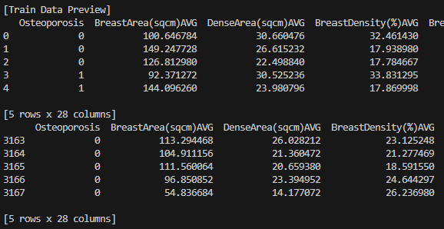
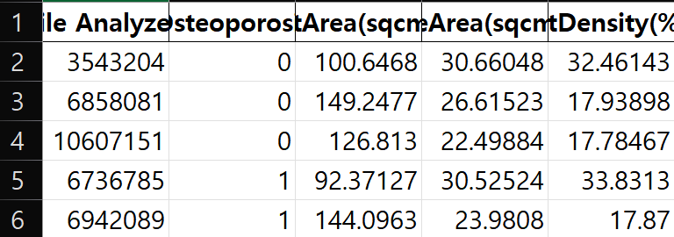
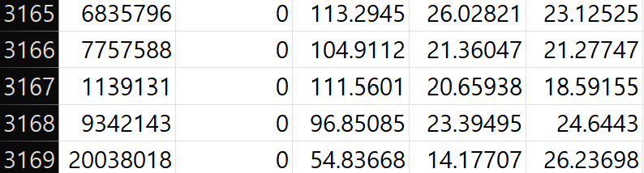
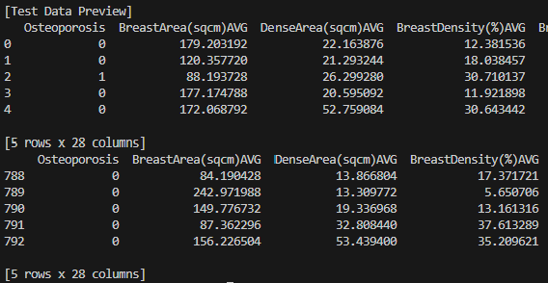
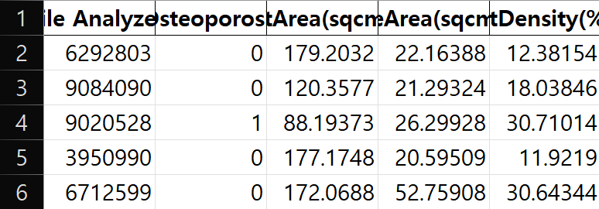
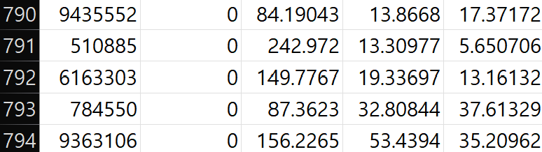
3. Detailed progress
Python Code & Print Check
Check Train and Test Dataset data directly

Slide 11
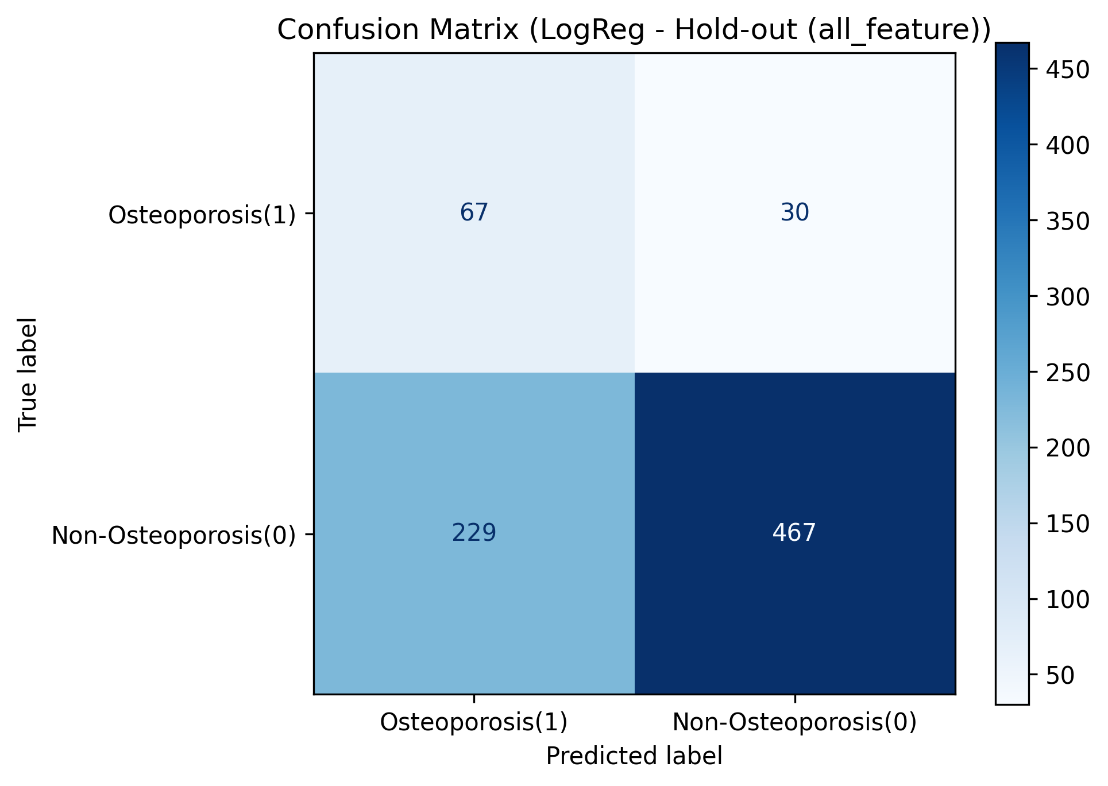
3. Detailed progress
Hold-out Model Train & Test
All Feature
Train : 3168, Test : 793
Accuracy | Precision | Recall | F1 | AUC
0.6734 | 0.2264 | 0.6907 | 0.3410 | 0.7521
Osteoporosis | pred | proba
0 | 0 | 0.3545
0 | 0 | 0.3055
1 | 1 | 0.5422
0 | 1 | 0.7409
0 | 1 | 0.5066
0 | 0 | 0.4614
0 | 0 | 0.4204
0 | 0 | 0.0197
0 | 1 | 0.6513
0 | 0 | 0.4672

Slide 12
3. Detailed progress
Hold-out Model Train & Test
Compare data TP and FN
Compare data TN and FP
feature | TP_mean | FN_mean | mean_diff | p_value
Age | 66.57 | 57.53 | 9.03 | 1.56E-08
근육량 | 30.42 | 35.34 | -4.92 | 3.99E-08
키 | 151.98 | 158.08 | -6.11 | 1.63E-06
체중 | 49.54 | 56.66 | -7.12 | 5.86E-05
음주여부 | 0.15 | 0.47 | -0.32 | 0.003459
체지방량 | 15.80 | 18.33 | -2.52 | 0.049383
BMI | 21.54 | 22.73 | -1.19 | 0.100763
흡연여부 | 0.03 | 0.20 | -0.17 | 0.114011
feature | TN_mean | FP_mean | mean_diff | p_value
체중 | 60.04 | 51.18 | 8.86 | 1.78E-65
근육량 | 36.41 | 31.77 | 4.64 | 1.3E-46
키 | 158.74 | 153.21 | 5.52 | 1.13E-41
체지방량 | 20.51 | 16.22 | 4.28 | 5.45E-26
BMI | 23.88 | 21.87 | 2.00 | 6.27E-18
Age | 58.16 | 63.03 | -4.87 | 4.69E-17
허리둘레 | 78.68 | 74.09 | 4.59 | 4.29E-12
Avg Breast Area(cm²) | 126.56 | 110.89 | 15.67 | 3.94E-08
체지방율 | 33.68 | 31.40 | 2.28 | 8.09E-06
복부내장지방량 | 2.07 | 1.58 | 0.49 | 1.69E-05
Avg Dense Area(cm²) | 30.24 | 27.10 | 3.14 | 2.88E-05

Slide 13

3. Detailed progress
Hold-out Model Train & Test
Feature: [Age, BMI, 체중, 근육량, 체지방량, 키]
Train : 3168, Test : 793
Accuracy | Precision | Recall | F1 | AUC
0.6646 | 0.2265 | 0.7216 | 0.3448 | 0.7533
Osteoporosis | pred | proba
0 | 0 | 0.4781
0 | 0 | 0.3720
1 | 1 | 0.5961
0 | 1 | 0.6675
0 | 1 | 0.6361
0 | 0 | 0.3539
0 | 1 | 0.5161
0 | 0 | 0.0425
0 | 1 | 0.6847
0 | 0 | 0.4383

Slide 14
3. Detailed progress
5-fold CV Model Train & Test
Total Data : 3961 → Stratified 5-fold CV
Fold | Valid set | Accuracy | Precision | Recall | F1 | AUC
1 | 793 | 0.6646 | 0.2181 | 0.6633 | 0.3283 | 0.7343
2 | 792 | 0.6869 | 0.2234 | 0.6289 | 0.3297 | 0.7317
3 | 792 | 0.6881 | 0.2396 | 0.7113 | 0.3584 | 0.7832
4 | 792 | 0.6755 | 0.2122 | 0.6082 | 0.3147 | 0.7135
5 | 792 | 0.6755 | 0.2297 | 0.7010 | 0.3461 | 0.7455
avg |  | 0.6781 | 0.2246 | 0.6625 | 0.3354 | 0.7417
std |  | 0.0097 | 0.0106 | 0.0446 | 0.0170 | 0.0259
fold | y_true | y_pred | y_proba
1 | 0 | 0 | 0.1472
1 | 1 | 0 | 0.0441
1 | 0 | 0 | 0.1825
1 | 0 | 1 | 0.5635
1 | 0 | 1 | 0.7058
1 | 0 | 1 | 0.9010
1 | 0 | 1 | 0.5410
1 | 0 | 0 | 0.1783
1 | 0 | 0 | 0.2494
1 | 0 | 1 | 0.5309
fold | y_true | y_pred | y_proba
2 | 1 | 1 | 0.8011
2 | 0 | 1 | 0.6472
2 | 0 | 0 | 0.0906
2 | 0 | 0 | 0.1347
2 | 0 | 1 | 0.5747
2 | 0 | 0 | 0.4517
2 | 0 | 0 | 0.4294
2 | 0 | 0 | 0.3262
2 | 0 | 0 | 0.3212
2 | 0 | 0 | 0.0936
fold | y_true | y_pred | y_proba
3 | 0 | 0 | 0.1501
3 | 0 | 1 | 0.6466
3 | 0 | 0 | 0.2858
3 | 0 | 0 | 0.3252
3 | 0 | 1 | 0.5590
3 | 0 | 0 | 0.1651
3 | 0 | 0 | 0.1895
3 | 0 | 0 | 0.1620
3 | 0 | 1 | 0.6504
3 | 0 | 1 | 0.6347
fold | y_true | y_pred | y_proba
4 | 1 | 0 | 0.3222
4 | 0 | 1 | 0.6545
4 | 0 | 0 | 0.4056
4 | 0 | 0 | 0.3052
4 | 0 | 0 | 0.1458
4 | 0 | 1 | 0.5858
4 | 0 | 1 | 0.6696
4 | 0 | 0 | 0.3705
4 | 0 | 1 | 0.5540
4 | 0 | 0 | 0.0809
fold | y_true | y_pred | y_proba
5 | 0 | 1 | 0.5039
5 | 0 | 0 | 0.1340
5 | 0 | 0 | 0.4932
5 | 1 | 1 | 0.5577
5 | 0 | 0 | 0.4264
5 | 0 | 0 | 0.2580
5 | 0 | 1 | 0.7154
5 | 0 | 1 | 0.6654
5 | 1 | 1 | 0.7475
5 | 0 | 0 | 0.2019

Slide 15


